Slide 1
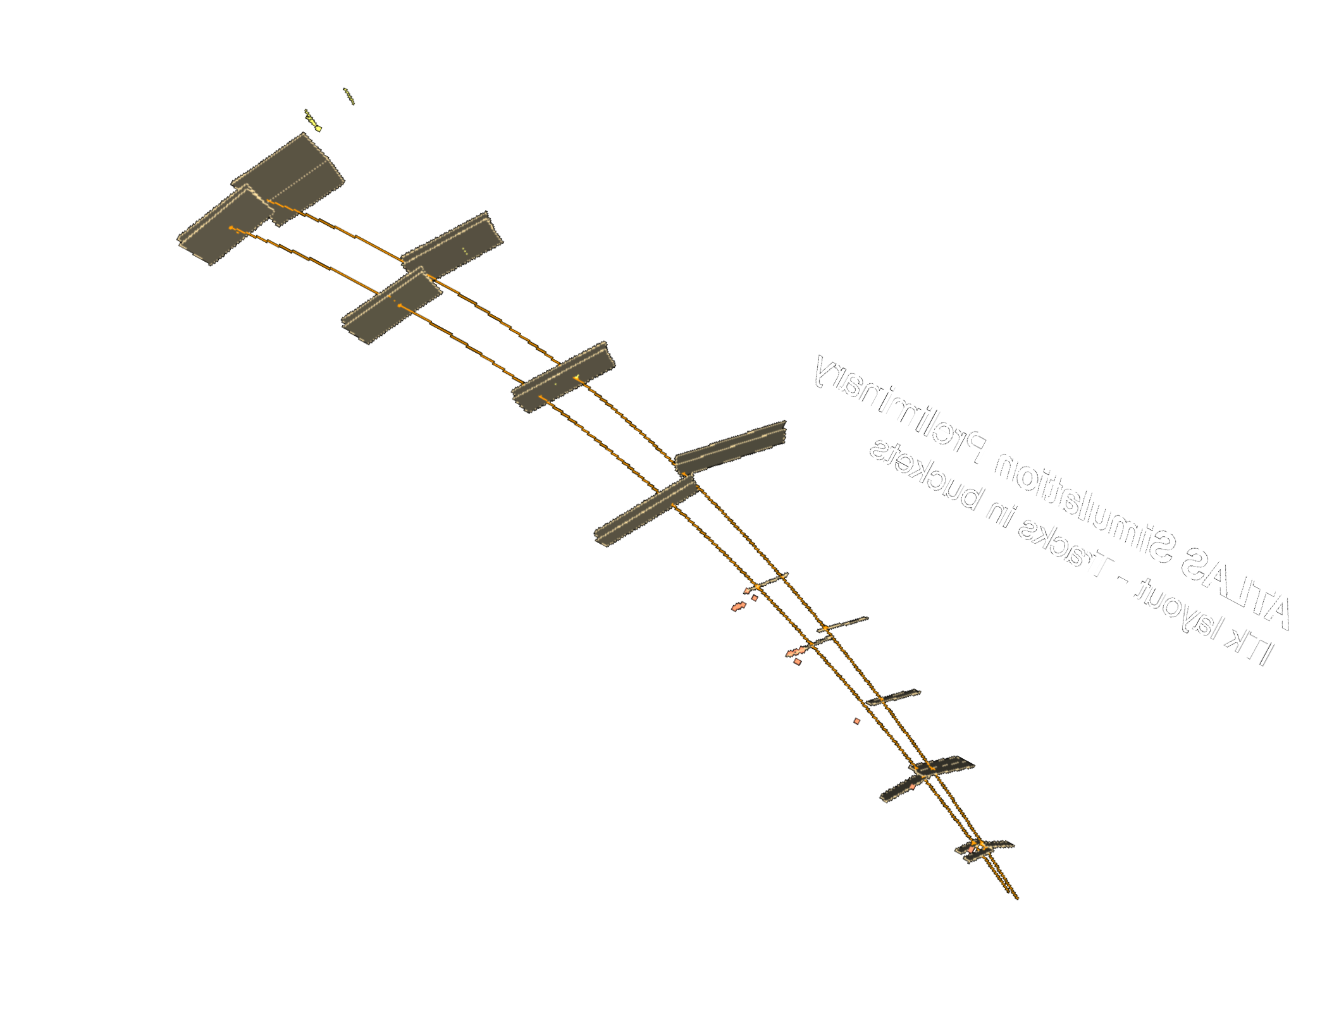

Hands-on Machine Learning for High Energy Physics
Dalila Salamani

Slide 2
Overview
ML in a nutshell
ML in HEP
Application for tracks reconstruction
Application for shower simulation
Python and ML libraries
Hands-on session
PartI: Python and ML libraries
PartII: Solve a classification problem with ML
PartIII: More evolved particle classification problem using h5 datasets
Material:
Check this drive folder: https://drive.google.com/drive/folders/1dVyczcgNPslrkBISfmgId1B53IGF52o5?usp=sharing
Or check github repo: https://github.com/DalilaSalamani/Hands-On-ML4HEP

Slide 3
Glossary
Data Mining
Artificial Intelligence
Deep Learning
Machine Learning
Computer Vision
Data Science

Slide 4
Glossary
Data Mining
Artificial Intelligence
DATA
Deep Learning
Knowledge
Machine Learning
Computer Vision
Data Science
Decisions

Slide 5
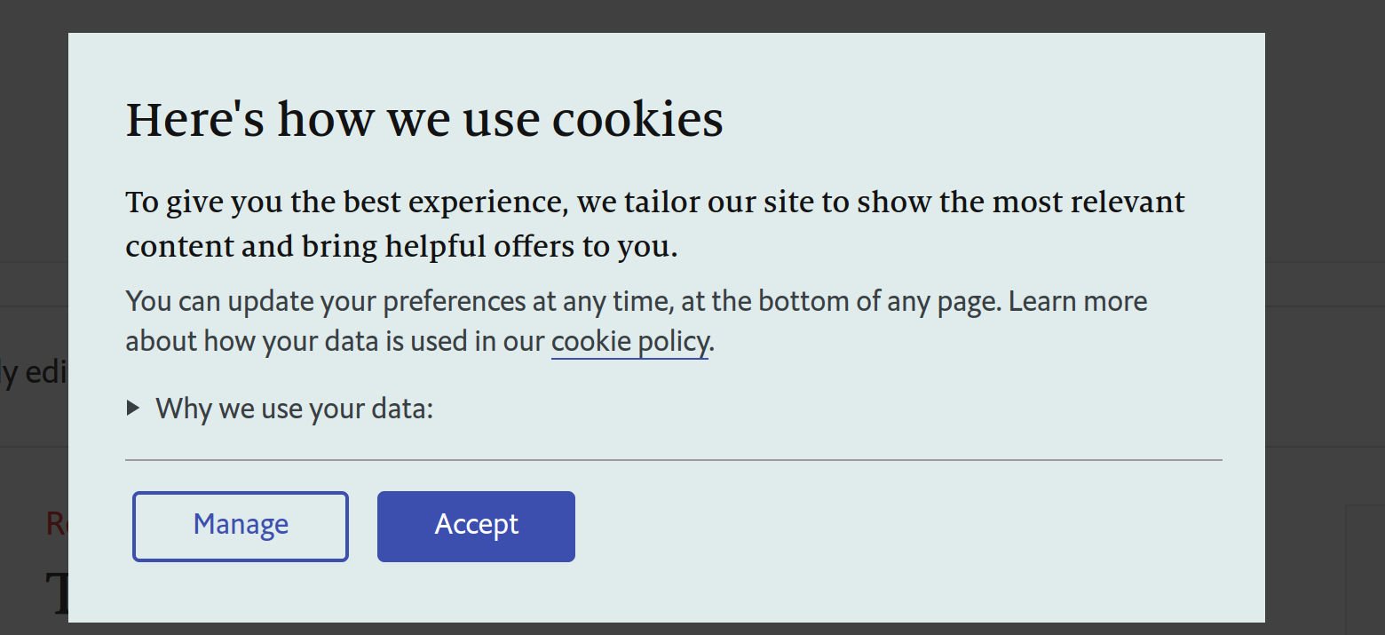



Data
Value (data) > value (oil) or value (gold)

Slide 6
Machine learning in a nutshell
prediction
Algorithms
parameters
Decision
function
Data
Model
New
data
Test
Train

Slide 7




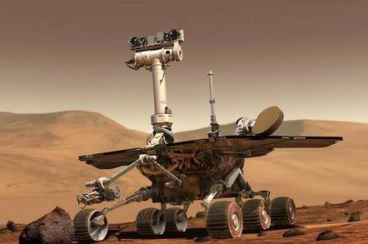
ML in the world: where you already use it

Slide 8
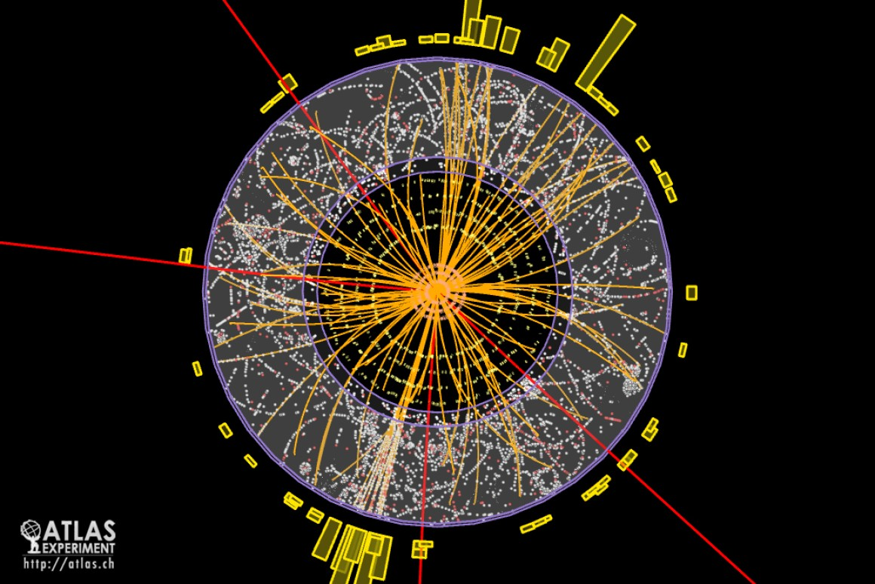
ML in HEP

Slide 9
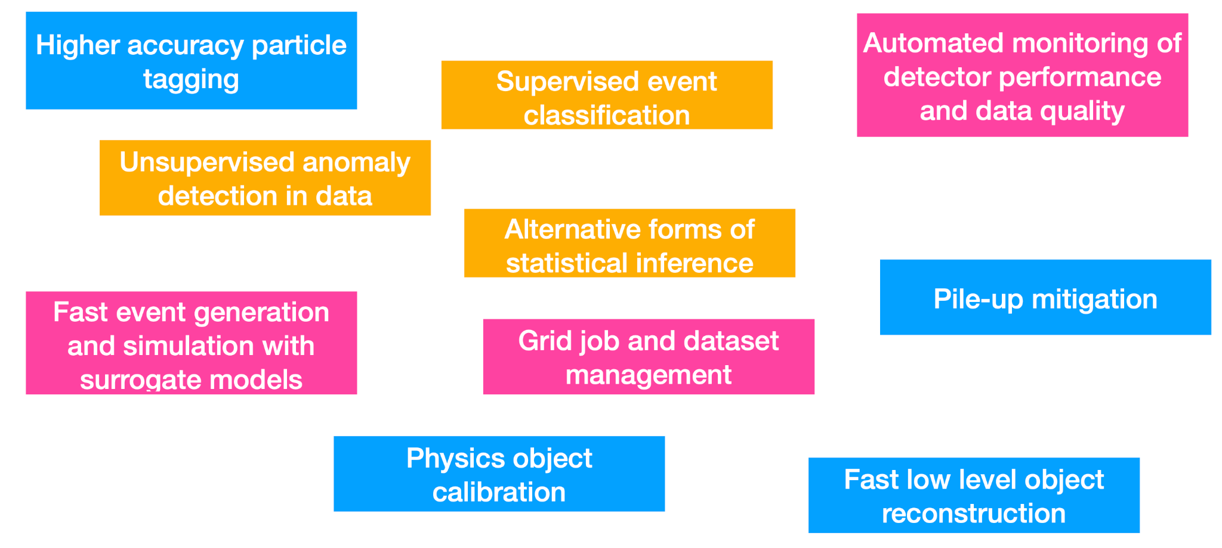
ML in HEP
Overview here : arXiv:1807.02876, arXiv:2102.02770

Slide 10

Particle Tracking with Machine Learning
The actual particle
(2) The measurements

Slide 11
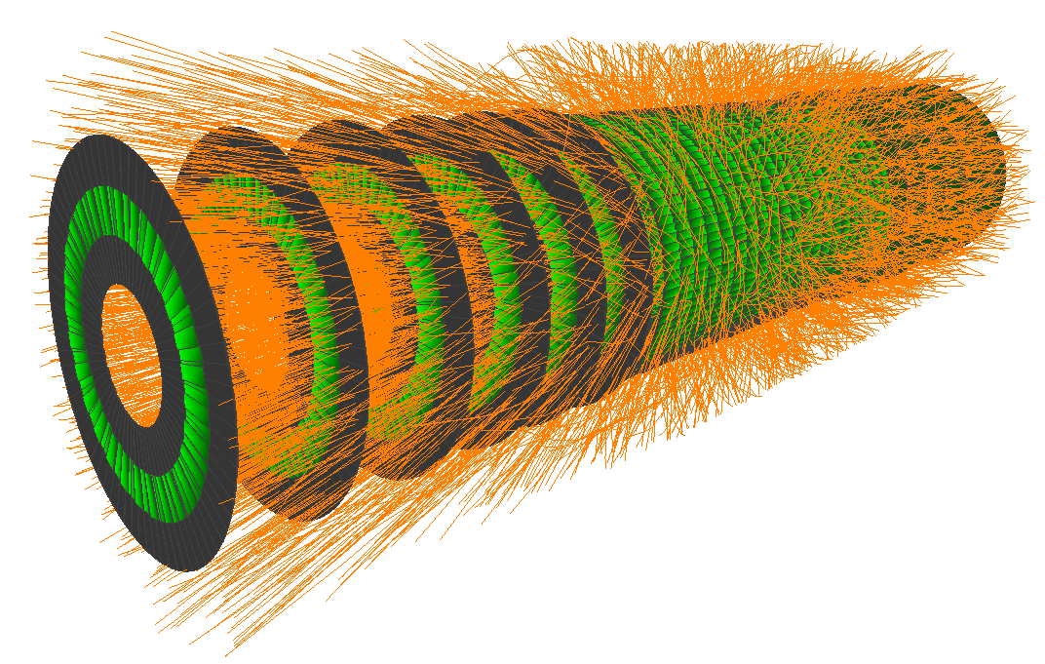
Particle Tracking with Machine Learning

Slide 12
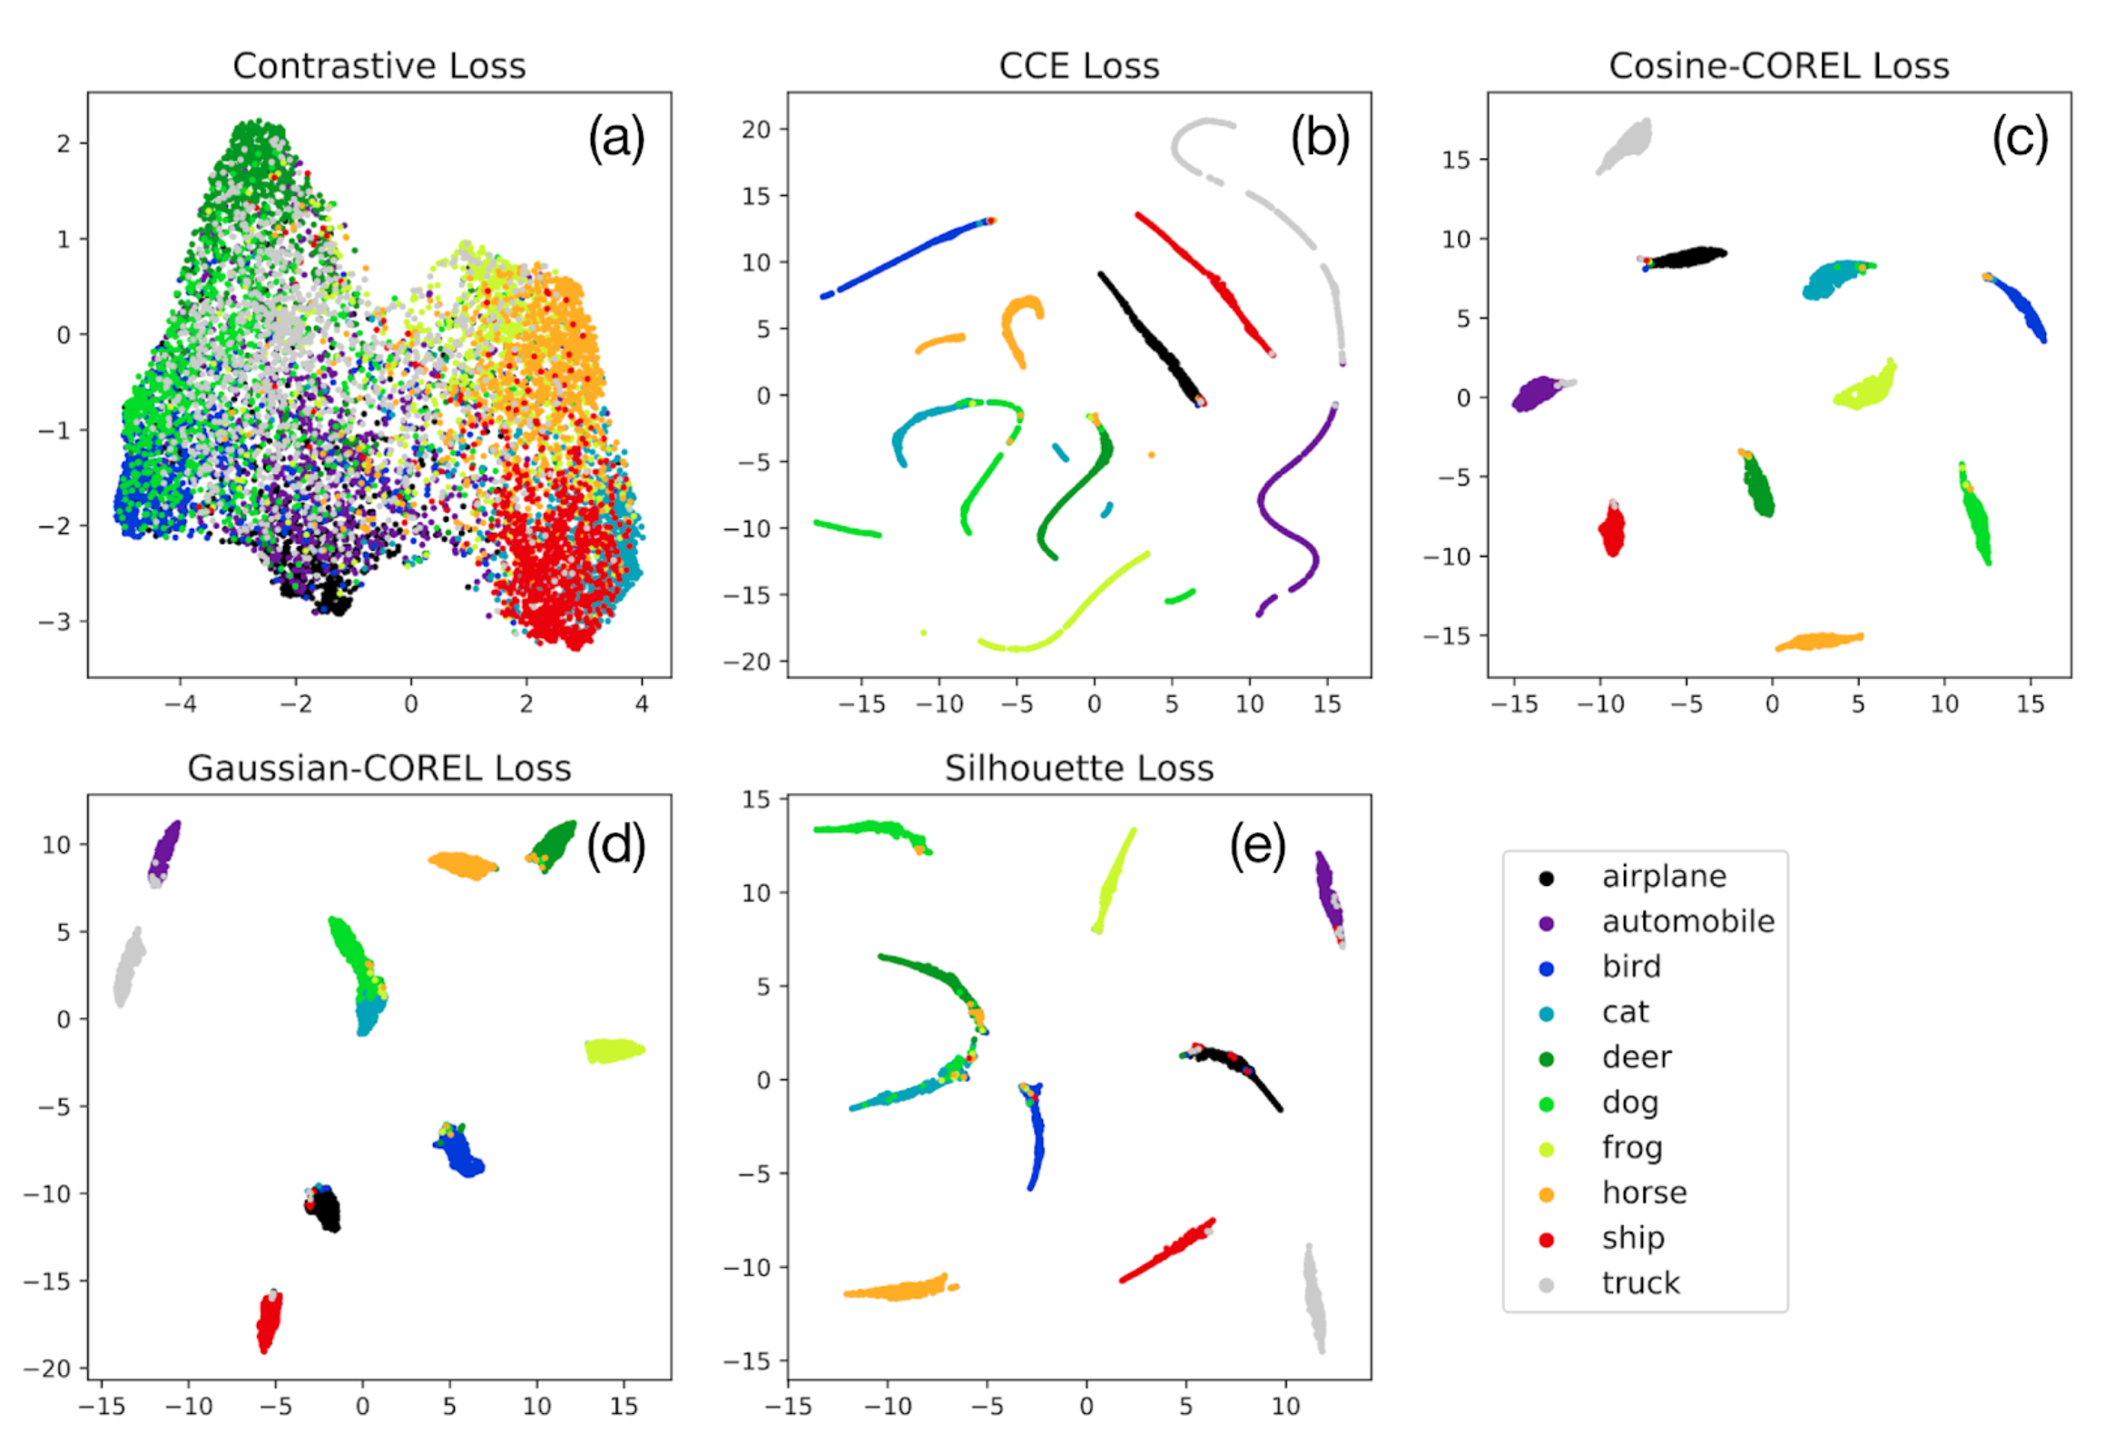
Metric (similarity) Learning
We know truth association from simulation

Slide 13

Generative model for fast simulation
def FastCaloMLSim(type,energy,eta):
return P(shower|type,energy,eta)
Variational Autoencoders (VAE)
Generative Adversarial Network (GAN)

Slide 14
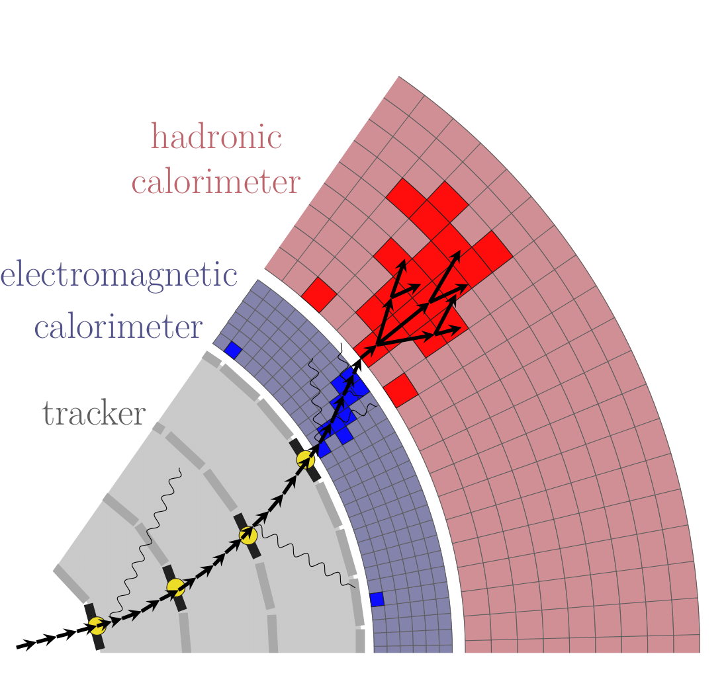
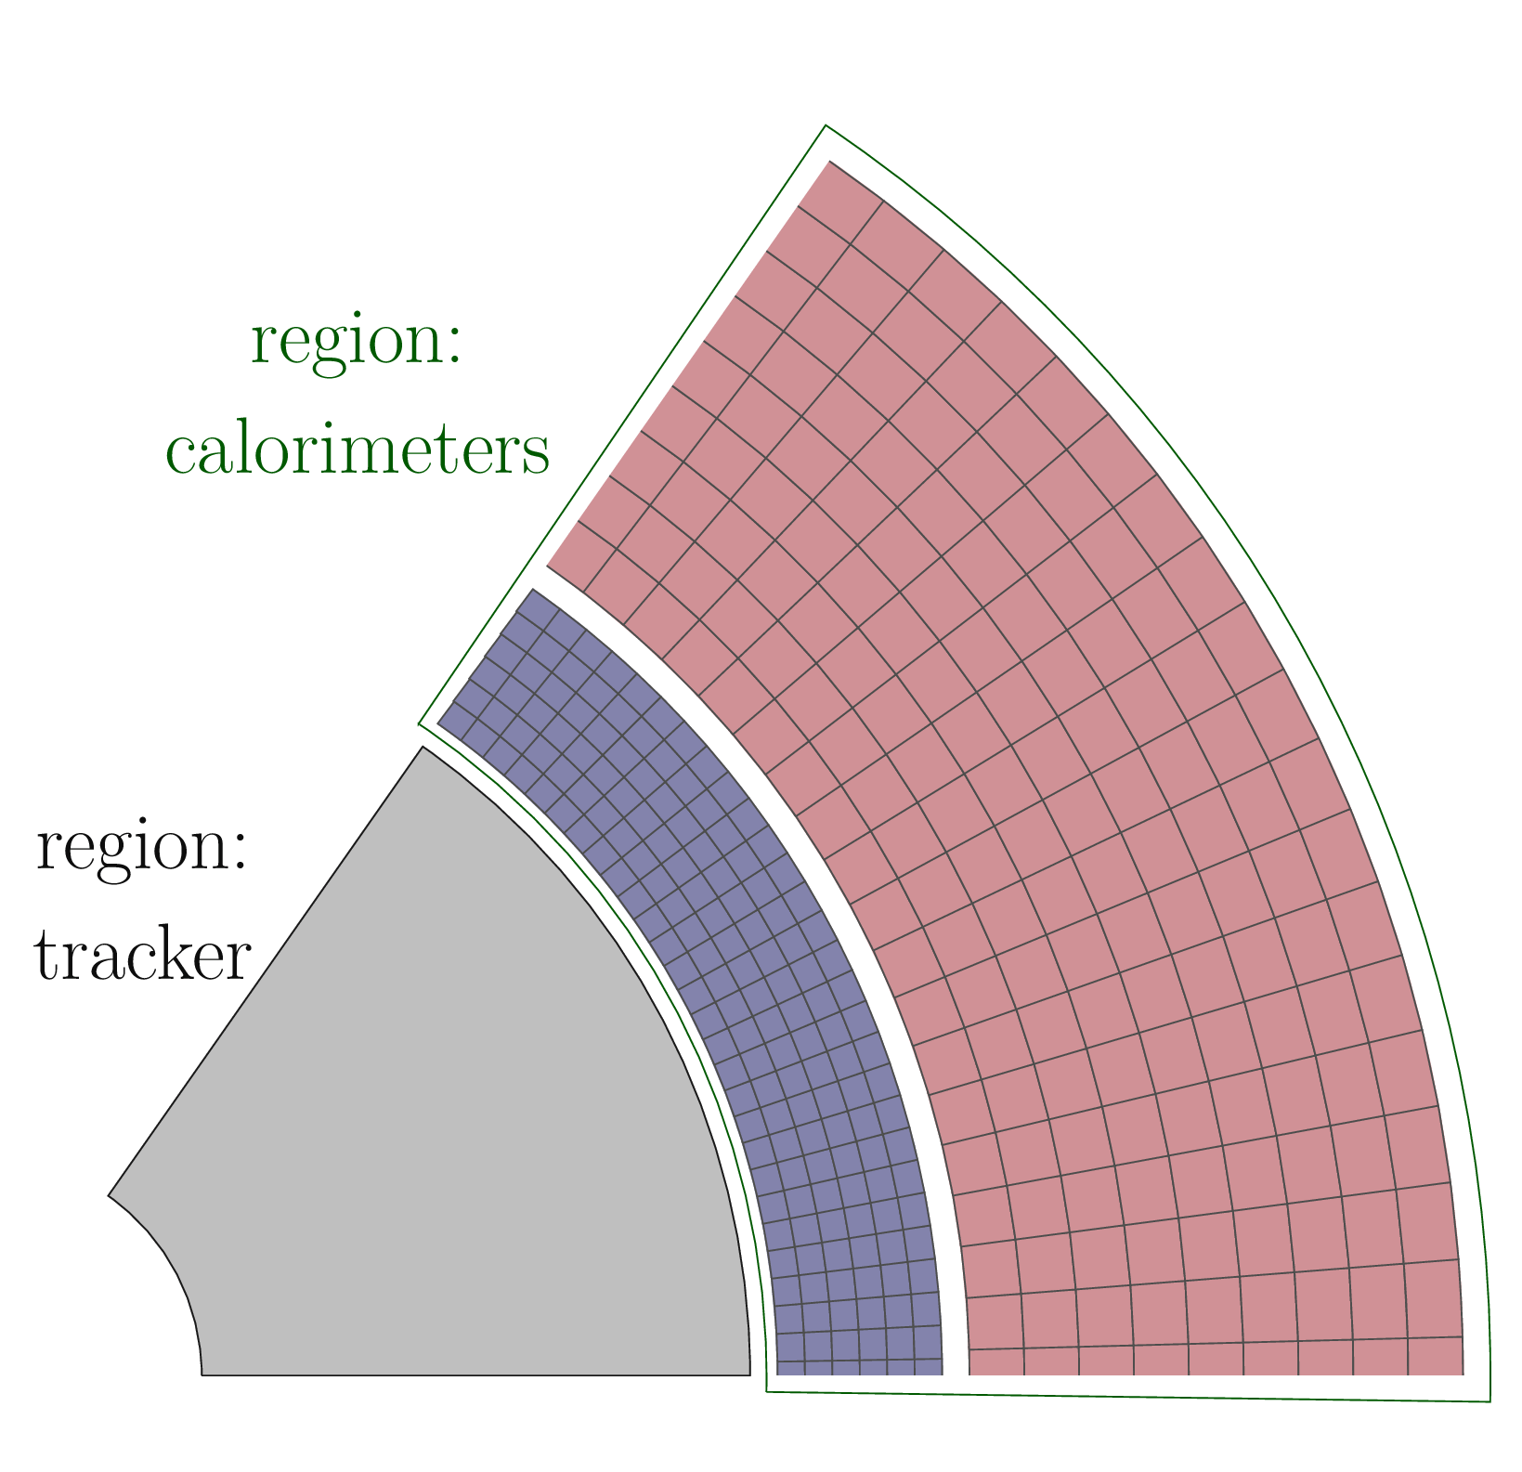
Generative model for fast shower simulation
FullSim
FastSim
Shortcut standard tracking & detailed simulation
[Geant4]

Slide 15
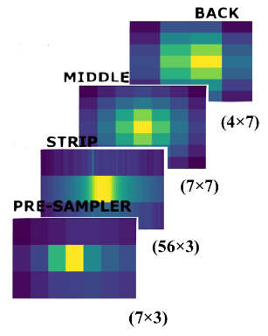
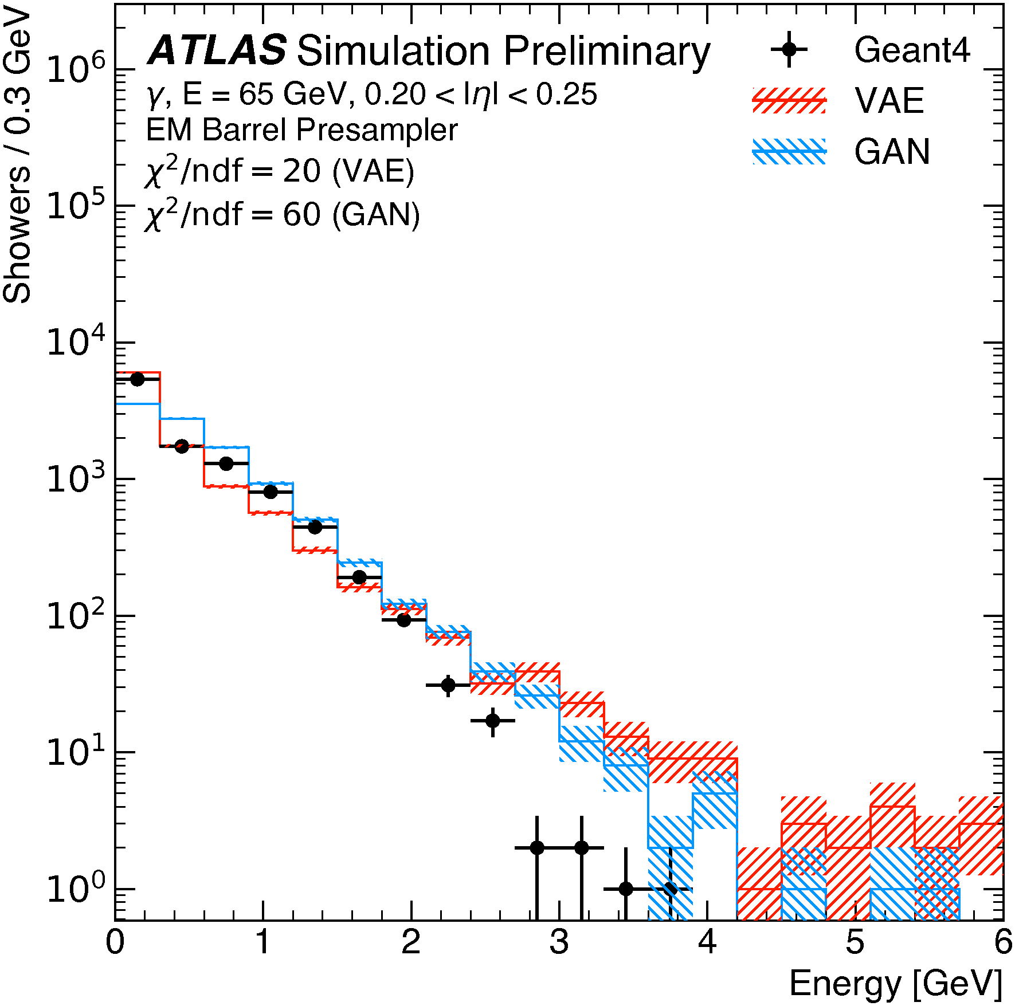
Generative model for fast simulation
Example of a photon shower development in the electromagnetic calorimeter

Slide 16
Machine learning in a nutshell
Reinforcement
Decision by reward
Select best option
Learn behaviour
Supervised
Unsupervised
Labeled data
Classification (discrete values)
Regression (real values)
No data labels
Clustering

Slide 17

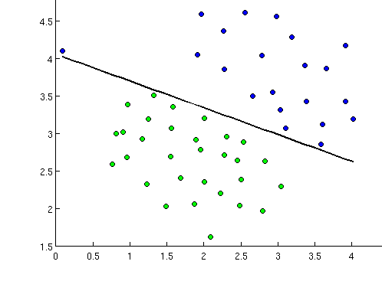
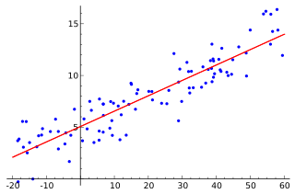
Classification / Regression / Clustering
Class 2
Class 1
Cluster 1
Cluster 2
Classify future observations
Known classes
No prior knowledge
Discover patterns
Predict continuous attribute

Slide 18
Quiz

Slide 19
What type of machine learning algorithm makes predictions when you have a set of input data and you know the possible responses?
Supervisory logic
Supervised learning
Clustering

Slide 20
What does a classification model do?
Predicts real number responses such as changes in temperature, date, or time
Clusters responses in groups based on similarity, to find patterns
Compares predicted data classifications to the actual class labels in the data
Assigns data to a predefined category

Slide 21
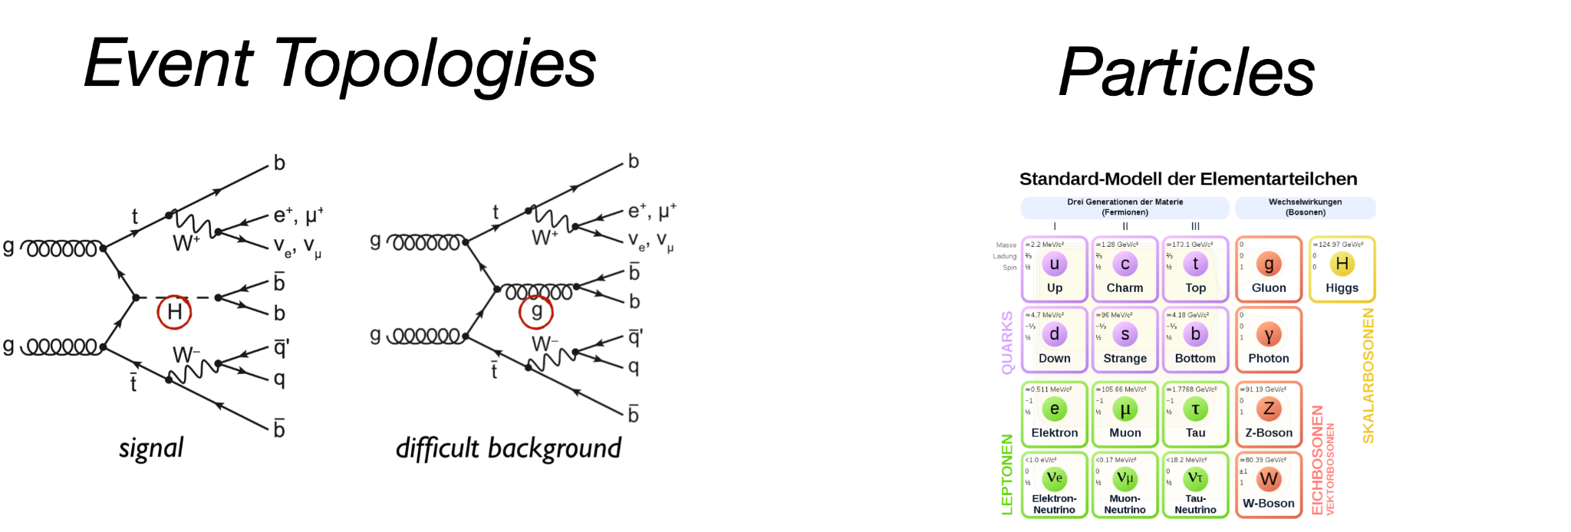
Is finding out if an event belongs to a signal or a background, a:
Classification
Regression
Clustering
problem?
Is finding out if particle belongs to a one of the particle types, a :
Classification
Regression
Clustering
problem?

Slide 22
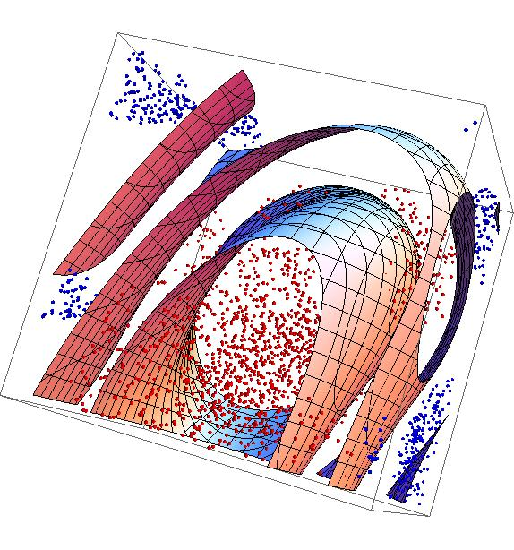

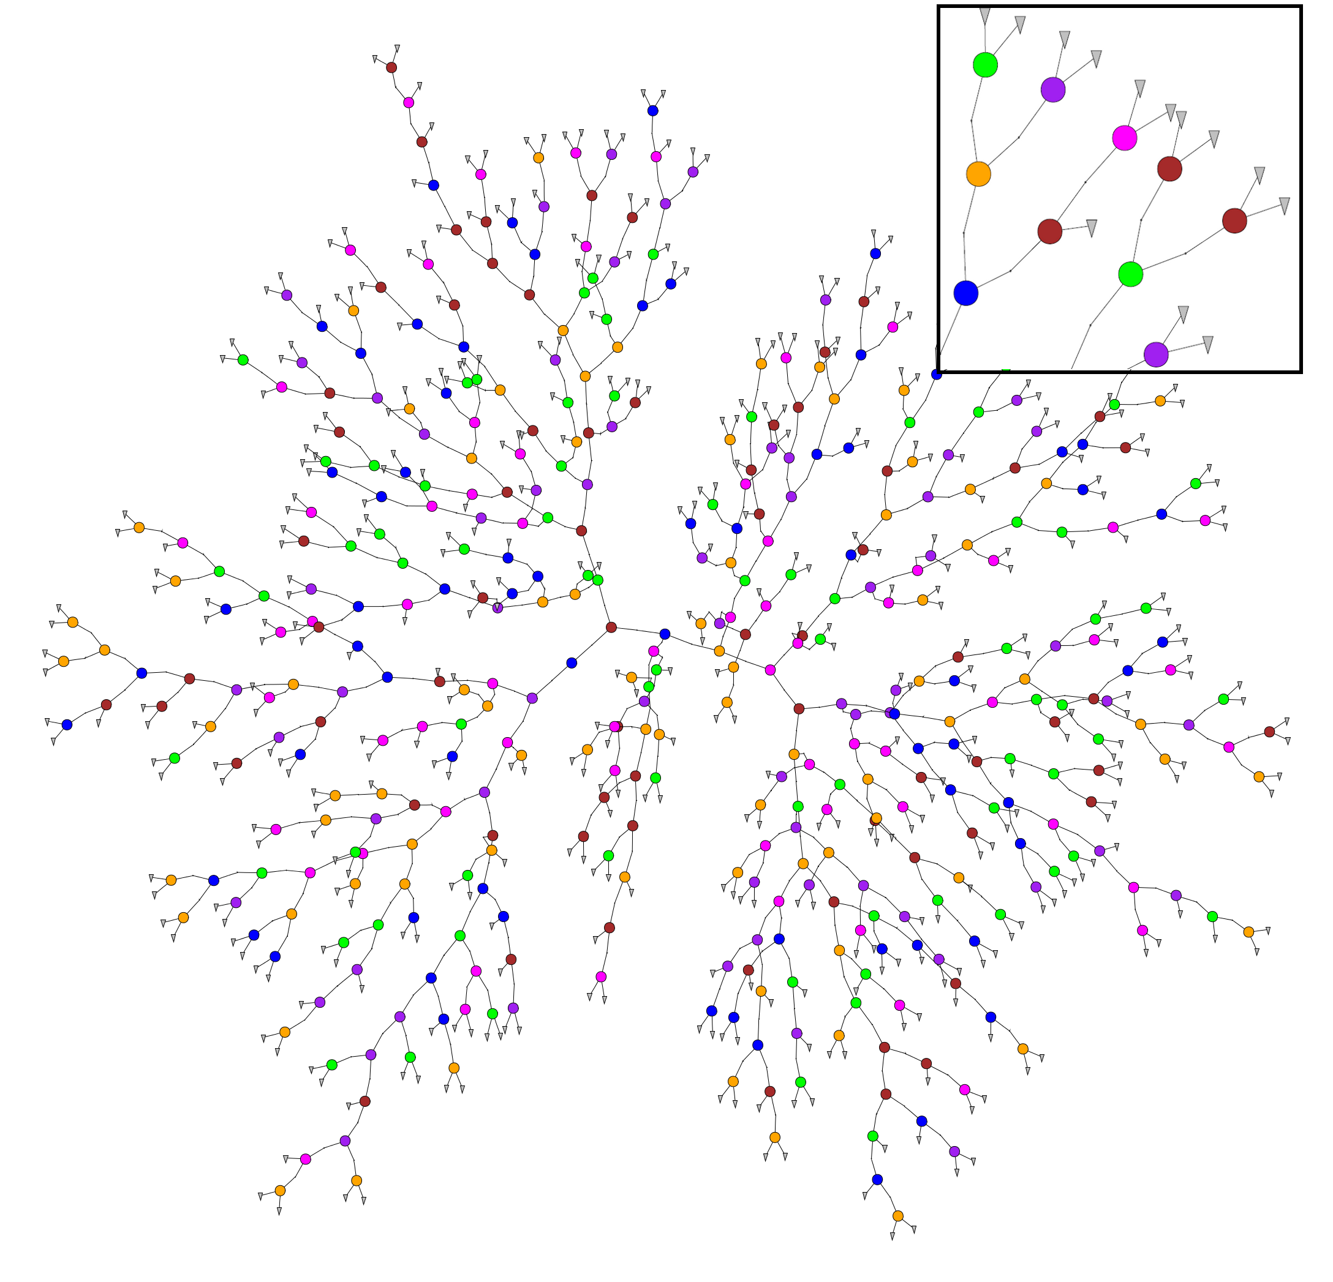
Support Vector Machines
Popular ML models
Neural Networks
Random Forests

Slide 23
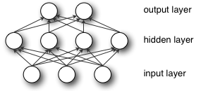
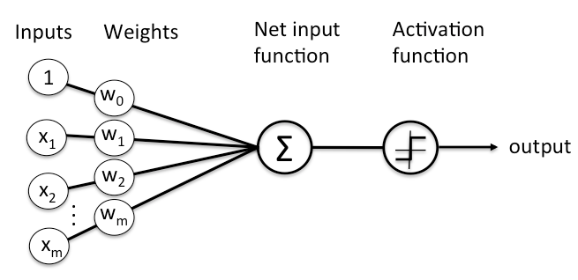
Neural networks
Inspired by biological neurons
Key components
Node: represents an artificial neuron
Weight: importance of the node in the learning process
Layer: a set of nodes.
Input
Hidden: learns different aspects about the data by minimizing an error/cost function
Output
Learning from sample observations by adjusting the weights to improve the accuracy of the result.
Learning is done by minimizing the observed errors.
Images from [Ref]

Slide 24
Why Python ?
General purpose language
Easy to use
Popular in data science community
Integrated packages : data processing, ML, data structure saving/loading

Slide 25
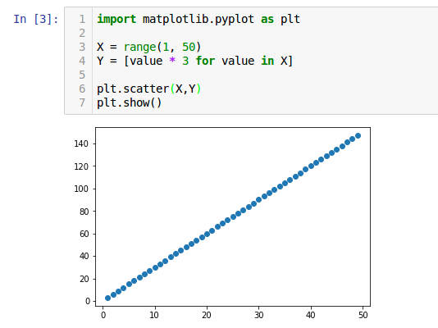
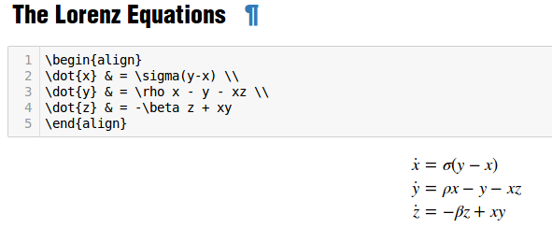
Jupyter notebook
Open-source web application to create live code, equations, visualizations and text [Ref]

Slide 26

Numpy
Package for scientific computing with Python [Ref]
N-dimensional array manipulation
sophisticated (broadcasting) functions
tools for integrating C/C++ and Fortran code
useful linear algebra, Fourier transform, and random number capabilities ...
Notes:
Fondamental

Slide 27

Uproot
Reader/Writer of the ROOT file format using only Python and Numpy [Ref]
No dependence on C++ ROOT
Uses Numpy to cast blocks of data from the ROOT file as Numpy arrays.
Designed to stream data into machine learning libraries in Python

Slide 28

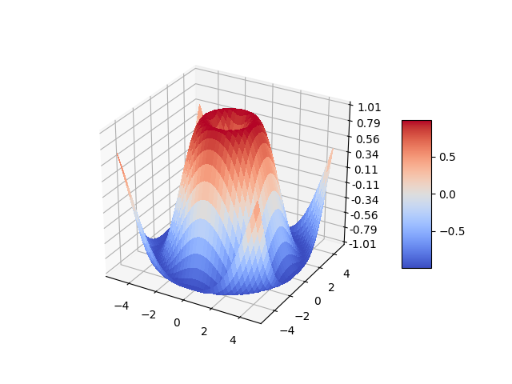
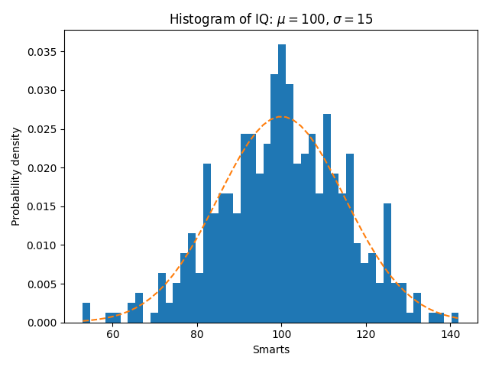
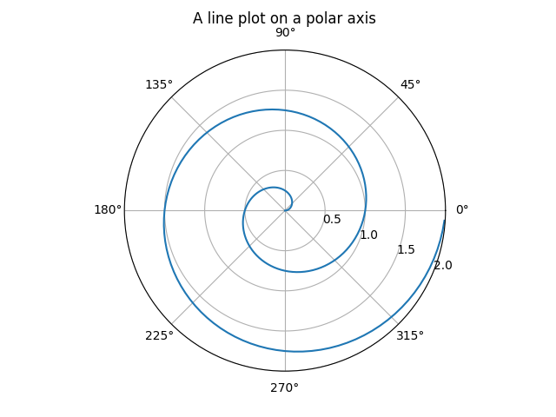
Matplotlib
Plotting library [Ref]

Slide 29
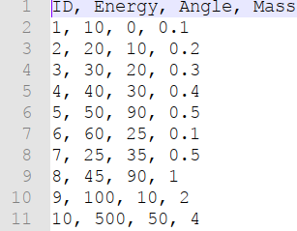
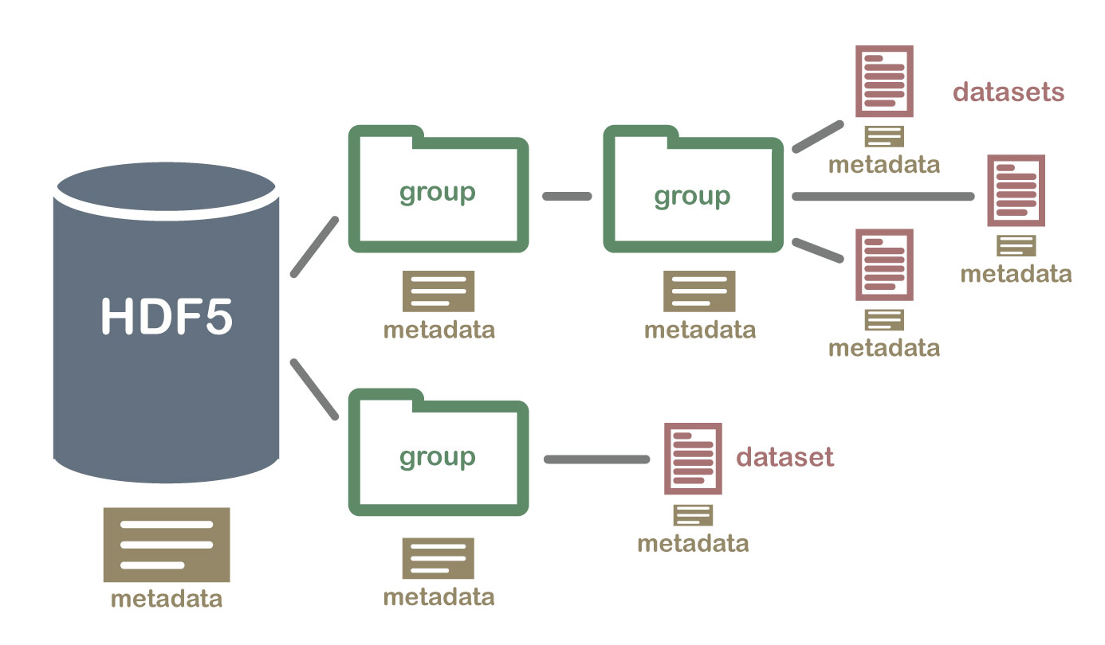
File structures: CSV, HDF5
CSV
A CSV is a comma-separated values file
It is a plain-text file
HDF5
Hierarchical Data Format (HDF)
It is a binary file format
Supports large, complex, heterogeneous data
Image from Ref

Slide 30
Part I : Hands-On session Python libraries
https://github.com/DalilaSalamani/Hands-On-ML4HEP/blob/main/HandsOnSession_PART_1.ipynb

Slide 31
Part II : Hands-On session Machine learning
https://github.com/DalilaSalamani/Hands-On-ML4HEP/blob/main/HandsOnSession_PART_2.ipynb

Slide 32

Google account
Do you have a google account ?
If not Go To
Create an account

Slide 33

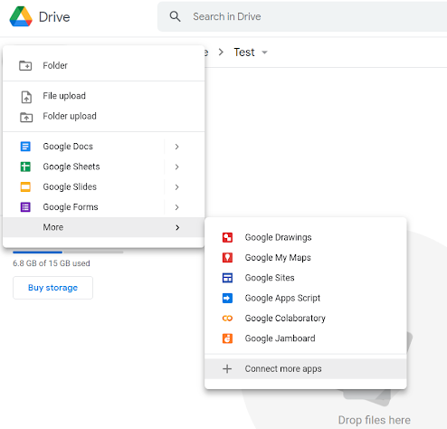
Drive
Go To
If you don’t have colab, go to

Slide 34


Adding colab
Once installed go to New-> More -> Google Colaboratory

Slide 35
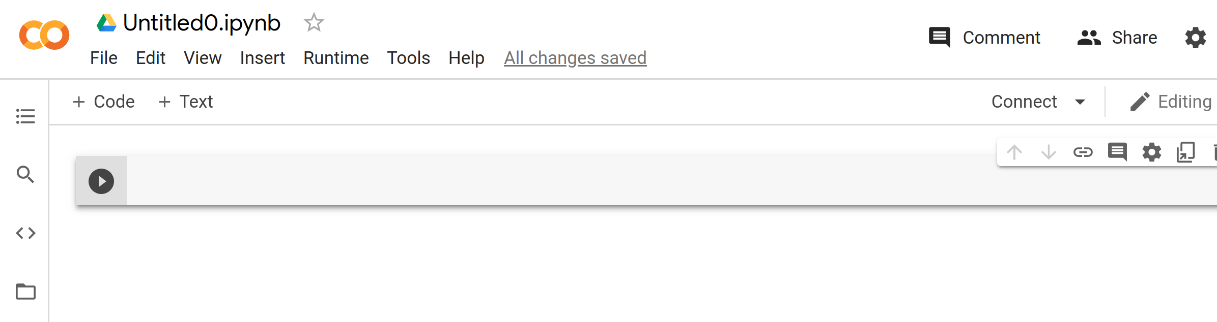
Colab
Name of the notebook
Cell
Run a cell

Slide 36
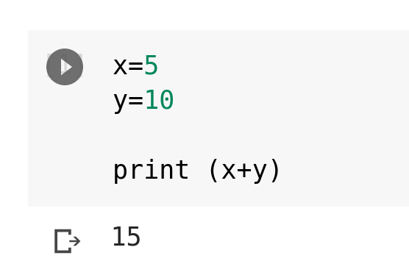
Colab
Output
Cell

Slide 37
Let’s test an ML model ….

Slide 38
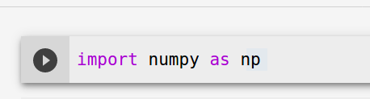
1/ Import numpy library

Slide 39
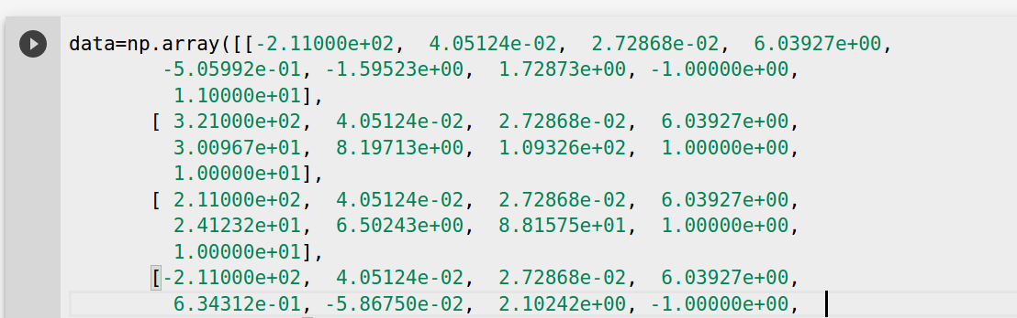
2/ Define your input dataset

Slide 40
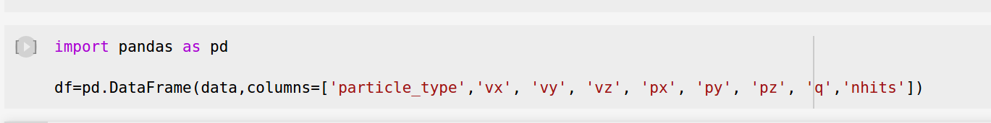
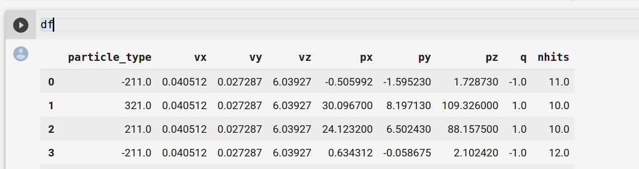
3/ Define the structure of your dataset using pandas library

Slide 41
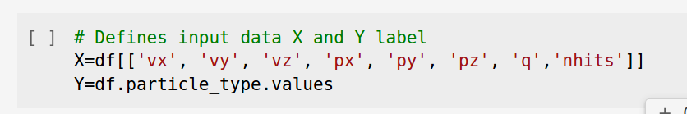
4/ Define the inputs/outputs of your model

Slide 42
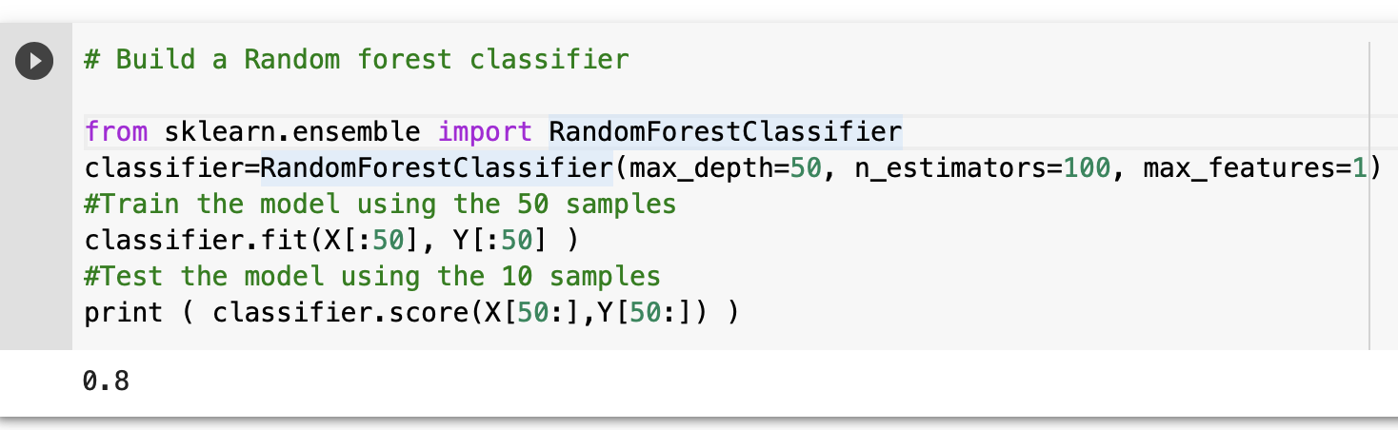
5/ Build a classifier
SKLearn is a ML library
the classifier
classifier parameters
train the classifier
test the classifier

Slide 43
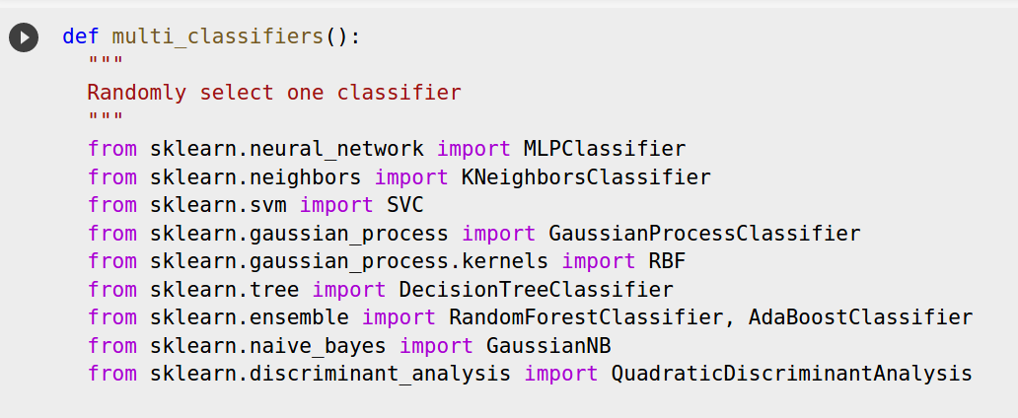
6/ Define a function to randomly select a ML classifier
…….
SKLearn is a ML library

Slide 44
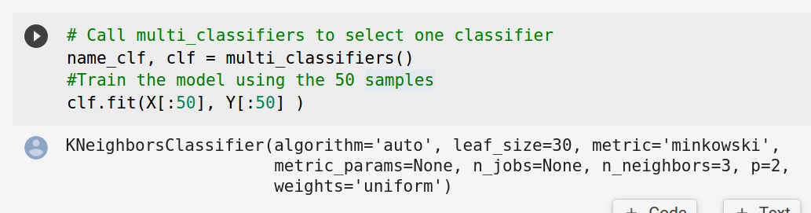
7/ Call your function and do .fit
The chosen classifier
To train your model

Slide 45
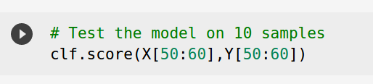
8/ Test your classifier

Slide 46
Part III : Hands-On session Machine learning
https://github.com/DalilaSalamani/Hands-On-ML4HEP/blob/main/HandsOnSession_PART_3.ipynb

